Slide 1


Third Review of Next Class Internship
Student Name : Apurbo Mondal
Roll No : A 07
College Mentor Name : Prof. Anup Dange
Industry Mentor Name : Rohit Kale
Review No: 3
Progress Period: From 24 March 2025 to 18 April 2025

Slide 2
Contents
About Company
My Role At Company
Project/ Work Assigned
Work Completed so far
Group meeting photos
Task to be Completed Up to Next Review
About Domain/ Technology Used
Conclusion

Slide 3
About Company
Company Name: NextClass (Upclick Labs OPC Pvt. Ltd.)
Company Address: 91 Springboard, Bannerghatta Rd, Dollars Colony, Phase 4, J. P. Nagar, Bengaluru, Karnataka, 560076
CEO: Dr. Prashant Chaudhari
Mentor Name: Rohit Kale

Slide 4

About Next Class: An Ed-Tech Startup
Next Class
Next Class is a growing ed-tech startup dedicated to providing high-quality online education through an interactive and user-friendly platform. The company offers a diverse range of courses designed to cater to students from various academic backgrounds and professional fields.
The mission of Next Class is to bridge the gap between learners and high-quality education by leveraging technology to create engaging and accessible learning experiences. The platform incorporates advanced learning tools such as live sessions, AI-driven personalized recommendations, and interactive assessments. With a focus on innovation, Next Class continuously enhances its educational services by integrating modern web development practices.

Slide 5

My Role as a Full-stack Web Intern
The development team at Next Class is responsible for ensuring seamless performance, optimizing the user experience, and implementing new features that align with the company’s vision.
They work collaboratively to enhance the platform's functionality, improve scalability, and ensure a smooth learning experience for users.
By leveraging modern web development technologies and best practices, the team focuses on building a responsive, efficient, and user-friendly interface.
Additionally, they continuously refine system performance, address technical challenges, and integrate innovative solutions to support the platform’s growth and long-term success.

Slide 6
Projects/Works Assigned
Developing an E-commerce Website
Working on Developing an E-commerce Website along with me team.
Using of all the Frontend, Backend and Database Technologies learnt during the training process.
Collaborating with mentors and team members for an optimal development and making of the project.

Slide 7
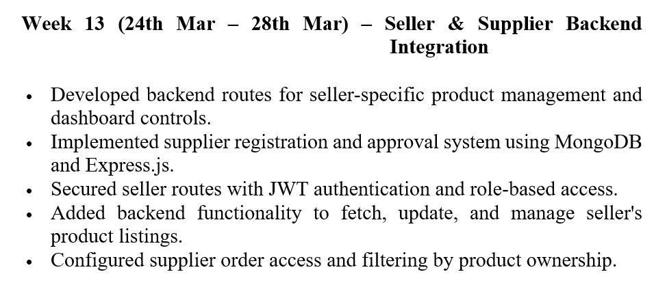
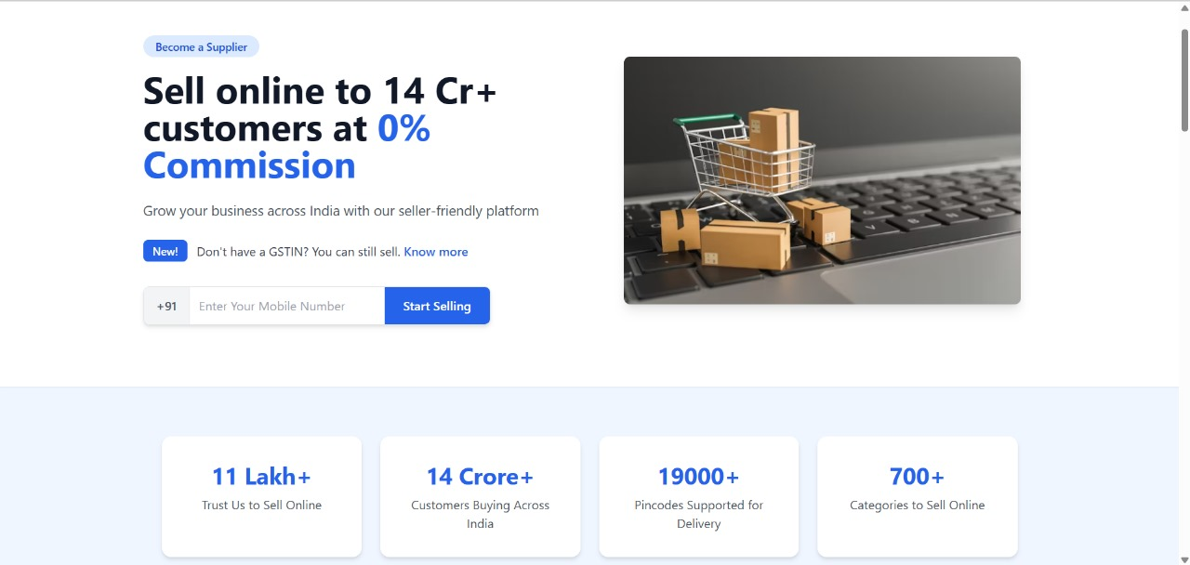
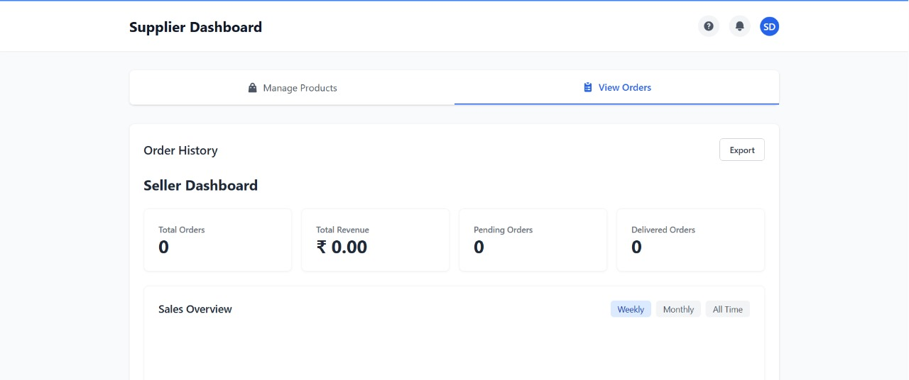
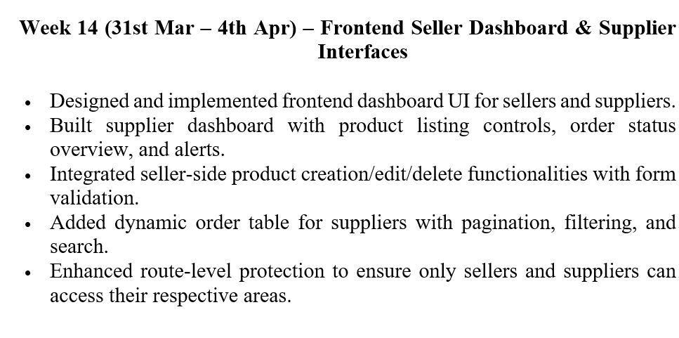
Work Completed So Far

Slide 8
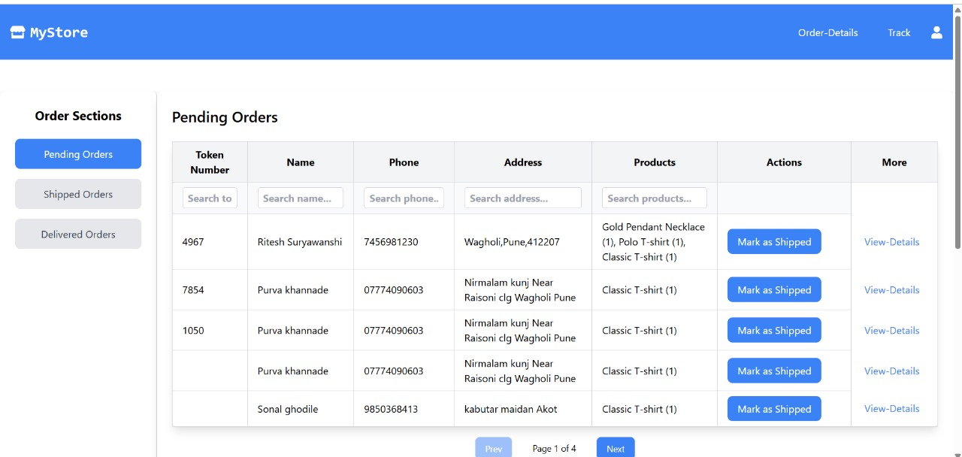
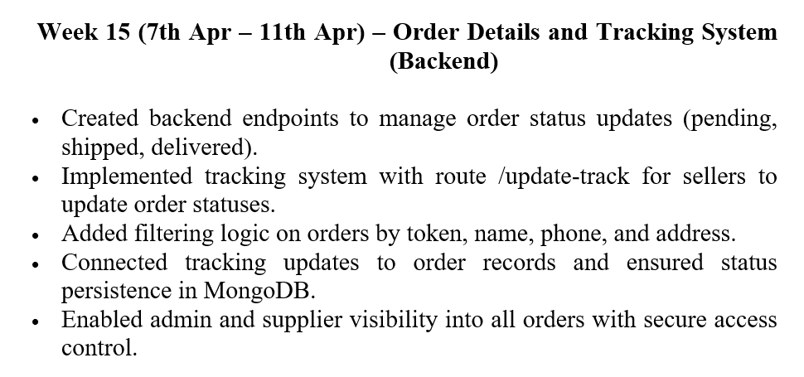
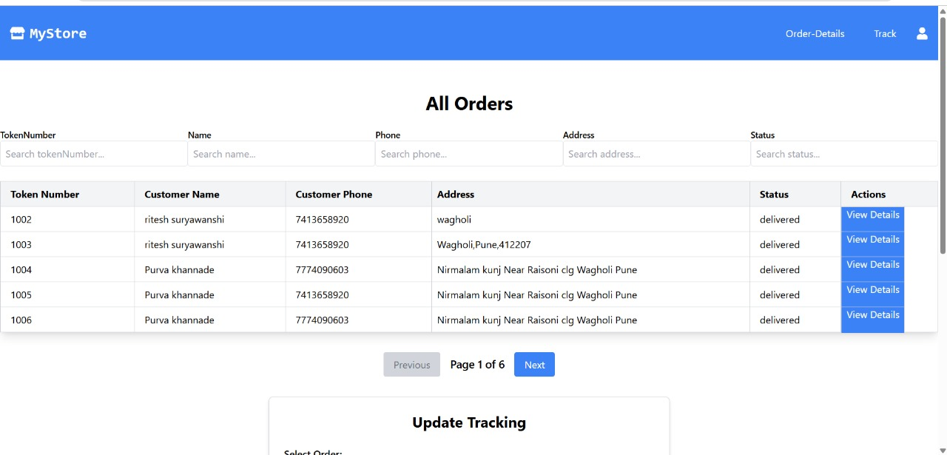
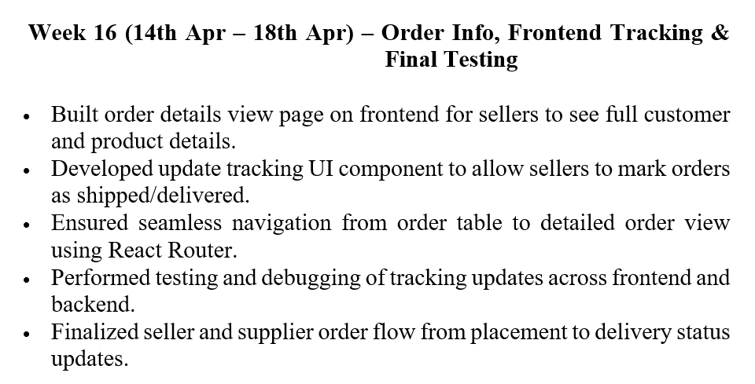

Slide 9
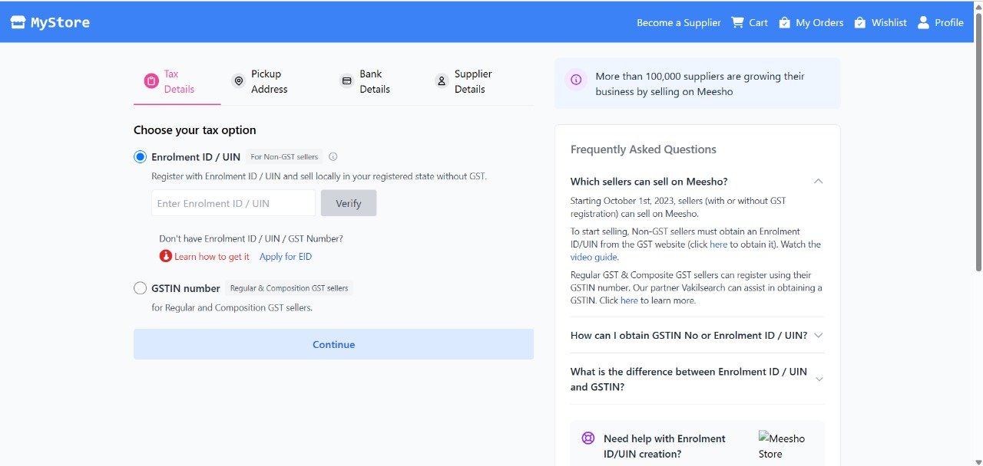
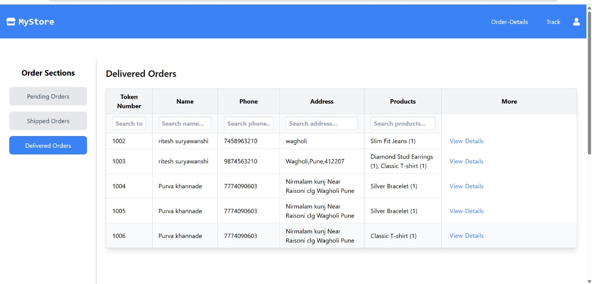
Become a Supplier page
Delivered Orders page

Slide 10
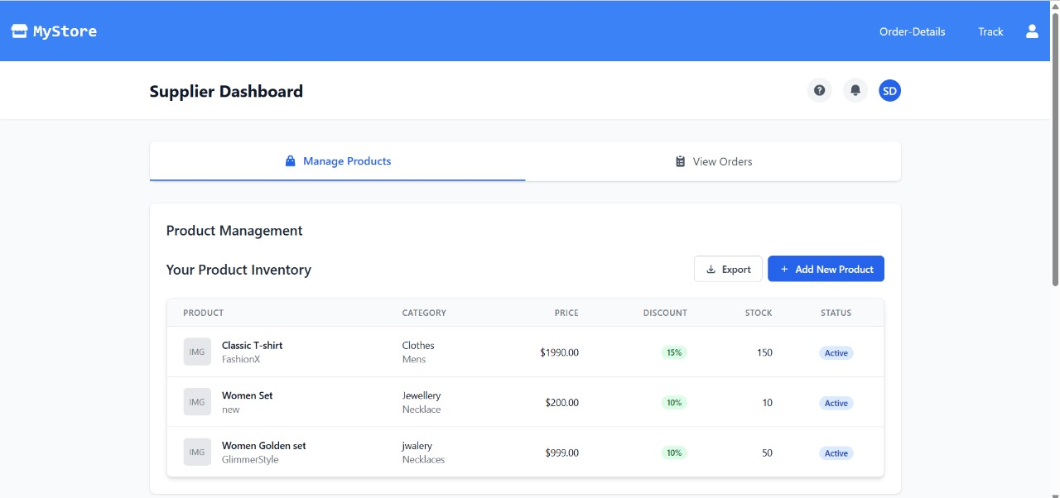
Become a Supplier Page
Supplier Dashboard

Slide 11
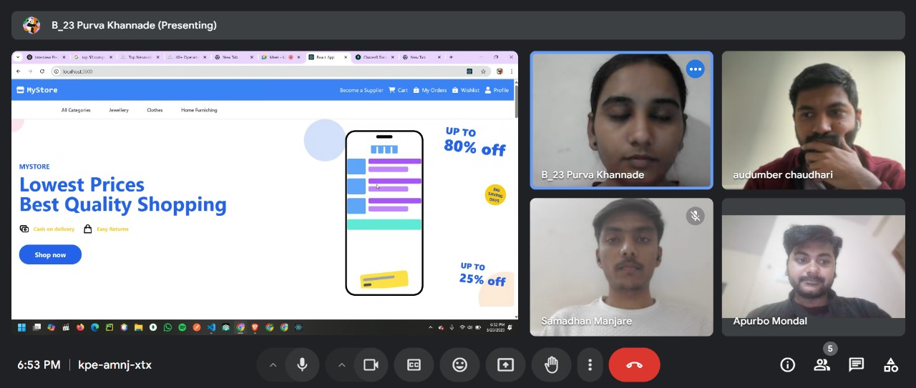
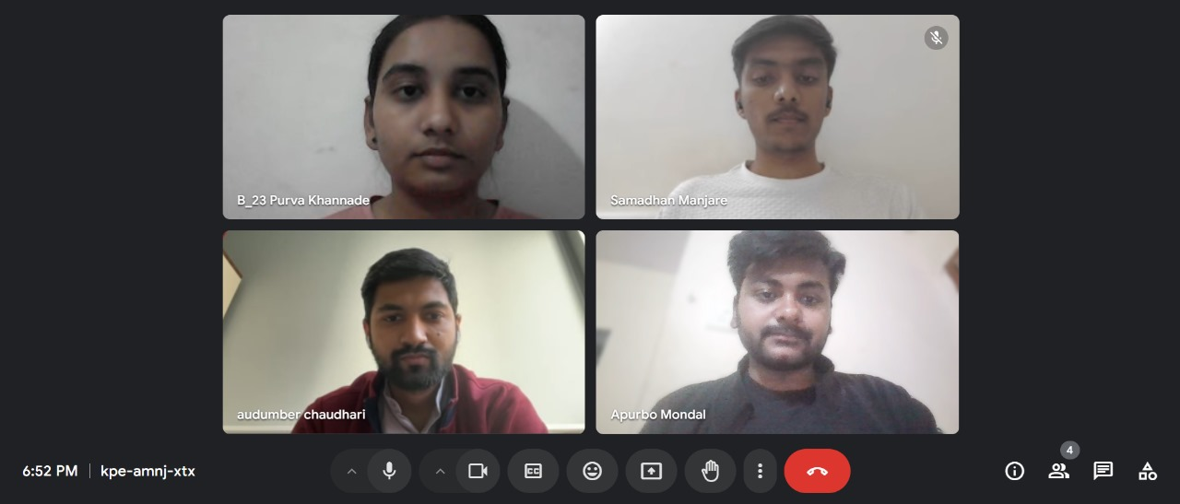
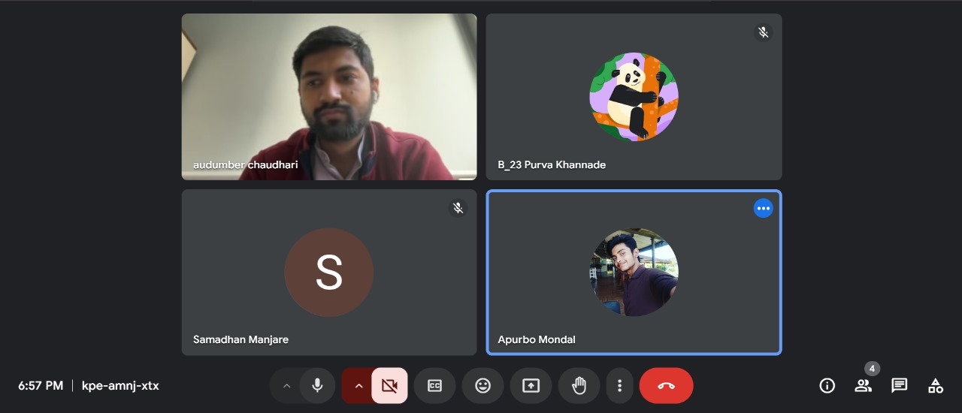
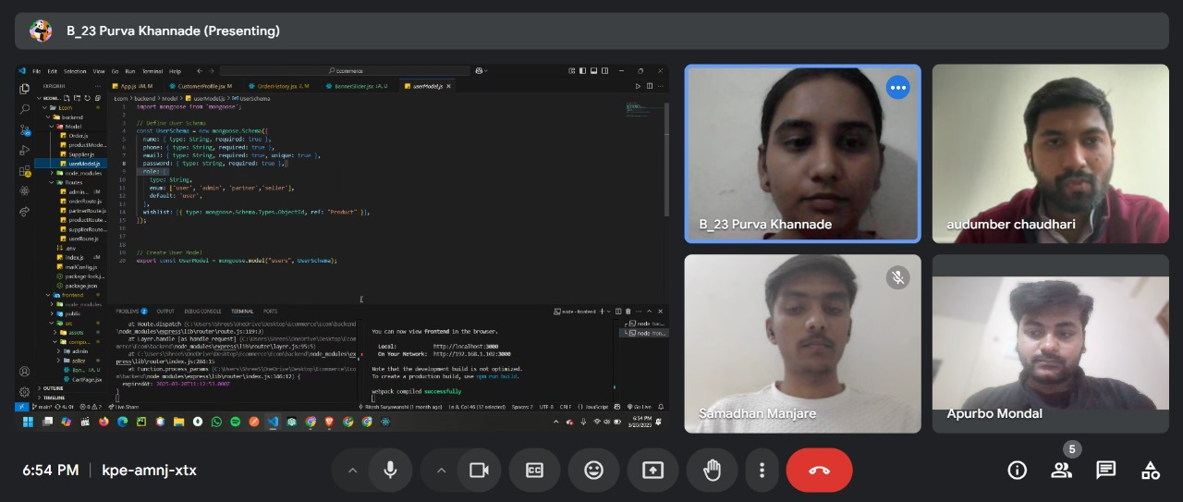
Group Meeting Photos

Slide 12
Tasks to be Completed Up to Next Review
Working on the most essential module for the website that is the Admin module.
Adding more components to the website.
Enhancing the overall user experience and friendliness.
Making the website ready for final delivery to client.

Slide 13
About Domain/ Technology Used
Web development involves a combination of frontend and backend technologies that work together to create interactive and functional web applications. Below is an overview of key technologies used in full-stack development.
Frontend Technologies (Client-Side) :-
React.js – A powerful JavaScript library for building interactive and dynamic UI components.
Tailwind CSS / UI – For creating responsive and visually appealing designs.
React Context API – For efficient state management across the application.
REST APIs – To efficiently fetch and manage data from the backend.
Backend Technologies (Server-Side) :-
Node.js – A scalable JavaScript runtime for handling server-side logic.
Express.js – Web frameworks for building efficient APIs and backend logic.
MongoDB – Databases for storing user data, courses, and assessments.
REST APIs – For efficient data exchange between frontend and backend.

Slide 14

Conclusion and Future Goals:
My internship at Next Class has till now has been a valuable learning experience, bridging the gap between theoretical knowledge and practical application.
The ongoing development process of the website assigned to me as a project has been a comprehensive learning experience, encompassing both frontend and backend development, as well as the integration of various functionalities to ensure a seamless user experience. Working on the project has also helped me strengthen my practical and hands-on knowledge on the domain. It has also helped me to gain knowledge and experience on how to deal with real time problems as they occur.
Plan to complete the development of the E-commerce website in the near future.

Slide 15
Thank You

